Slide 1
SWITCHING THEORY
LOGIC GATES
BOOLEAN POSTULATES-Postulates and theorems
De’MORGAN’S THEOREM
CANONICAL FORMS
K- MAPPING
QUINE Mc-CLUSKY METHOD
Sub code-ETEC-205
Faculty- Priyank Saxena

Slide 2
LOGIC GATES
A digital computer performs complicated operations by interconnecting large number of switches called logic gates.
Building Blocks for all the digital systems.
Works on Binary logic.
Three types of gates Basic, Universal and Extended gates

Slide 3
Basic gates
AND
OR
NOT
All Boolean functions can be implemented using the set {AND, OR, NOT}

Slide 4
AND gate
Input-1
Truth table
output
Input-2
Input1-x | Input2-y | Output-z
0 | 0 | 0
0 | 1 | 0
1 | 0 | 0
1 | 1 | 1
Z=X.Y

Slide 5
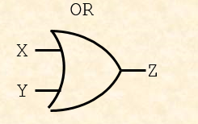
OR gate
Input1-x | Input2-y | Output-z
0 | 0 | 0
0 | 1 | 1
1 | 0 | 1
1 | 1 | 1
Z=X+Y

Slide 6
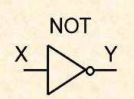
NOT gate
Input | output
0 | 1
1 | 0
Y=NOT X=X’

Slide 7
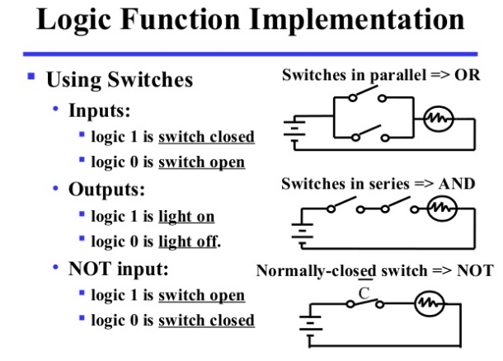

Slide 8
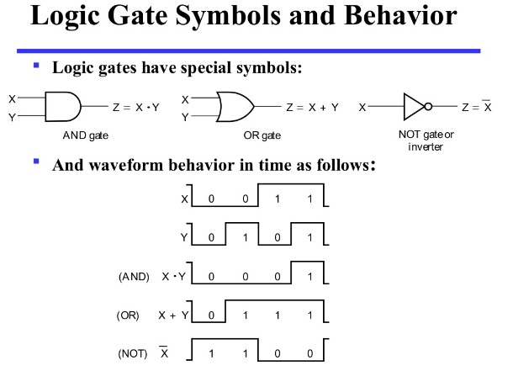

Slide 9
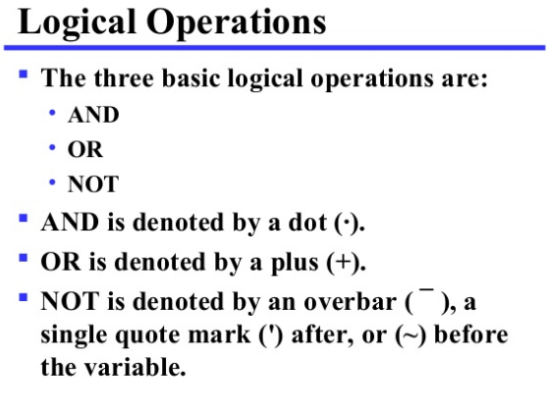

Slide 10
Operator Precedence
The operator Precedence for evaluating Boolean expression is:
Parentheses
NOT
AND
OR

Slide 11
Universal gates
Gates which can implement any Boolean function without the need to use any other type of gate
NAND and NOR are universal gates

Slide 12
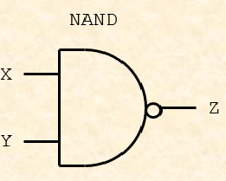
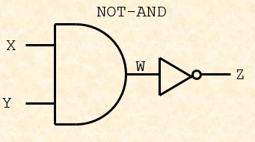
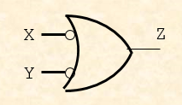

NAND gate
Input1 | Input2 | output
0 | 0 | 1
0 | 1 | 1
1 | 0 | 1
1 | 1 | 0

Slide 13
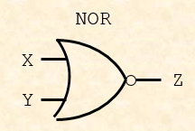
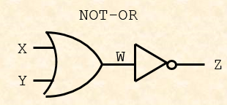
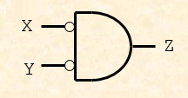

NOR gate
Input1 | Input2 | output
0 | 0 | 1
0 | 1 | 0
1 | 0 | 0
1 | 1 | 0

Slide 14
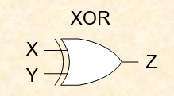

EXTENDED GATES-Ex-OR gate
Input1 | Input2 | output
0 | 0 | 0
0 | 1 | 1
1 | 0 | 1
1 | 1 | 0
Z=X Y
+

Slide 15
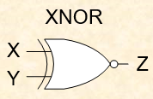

EXTENDED GATES-Ex-NOR gate
Input1 | Input2 | output
0 | 0 | 1
0 | 1 | 0
1 | 0 | 0
1 | 1 | 1

Slide 16
BUFFER
input
output
Input x | Output z
0 | 0
1 | 1
Z=X

Slide 17
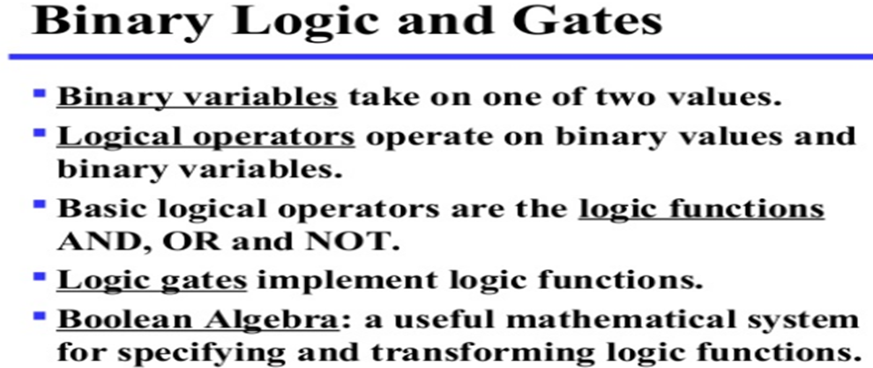

Slide 18
Comparing Boolean algebra with arithmetic and ordinary algebra.
Boolean algebra doesn’t have subtraction or division operations.
An operator called complement that is not available in ordinary algebra.
Ordinary algebra deals with the real numbers. Boolean algebra deals with 2 valued logic.

Slide 19
Description of the Laws of Boolean Algebra
Annulment Law – A term AND´ed with a “0” equals 0 or OR´ed with a “1” will equal 1
A . 0 = 0 A variable AND’ed with 0 is always equal to 0
A + 1 = 1 A variable OR’ed with 1 is always equal to 1
Identity Law – A term OR´ed with a “0” or AND´ed with a “1” will always equal that term
A + 0 = A A variable OR’ed with 0 is always equal to the variable
A . 1 = A A variable AND’ed with 1 is always equal to the variable

Slide 20
Description of the Laws of Boolean Algebra
Idempotent Law – An input that is AND´ed or OR´ed with itself is equal to that input
A + A = A A variable OR’ed with itself is always equal to the variable
A . A = A A variable AND’ed with itself is always equal to the variable
Complement Law – A term AND´ed with its complement equals “0” and a term OR´ed with its complement equals “1”
A . A’ = 0 A variable AND’ed with its complement is always equal to 0
A + A’ = 1 A variable OR’ed with its complement is always equal to 1

Slide 21
Description of the Laws of Boolean Algebra
Commutative Law – The order of application of two separate terms is not important
A . B = B . A The order in which two variables are AND’ed makes no difference
A + B = B + A The order in which two variables are OR’ed makes no difference
Double Negation Law /Involution– A term that is inverted twice is equal to the original term
(A’)’ = A A double complement of a variable is always equal to the variable

Slide 22
Basic theorems and properties of Boolean algebra
De Morgan´s Theorem – There are two “de Morgan´s” rules or theorems,
(A+B)’ = A’ . B’
(A.B)’ = A’ + B’
Distributive Law – This law permits the multiplying or factoring out of an expression.
A(B + C) = A.B + A.C (OR Distributive Law)
A + (B.C) = (A + B).(A + C) (AND Distributive Law)
Duality theorem
To get dual of an algebraic expression, we simply interchange OR and AND operators and
replace 1’s by 0’s and 0’s by 1’

Slide 23
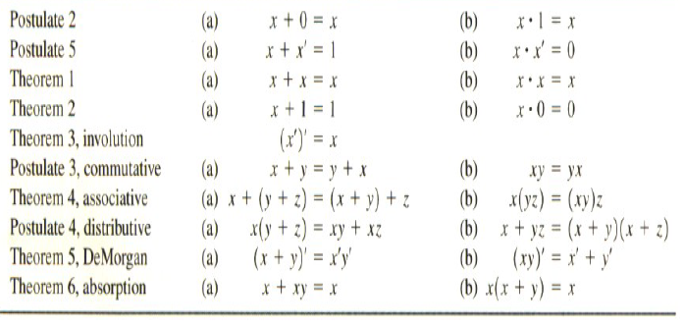
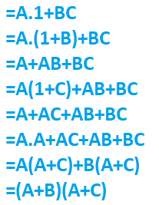
Proof for distributive (b)

Slide 24
Boolean expression
Consider the following logic equation
Z(A,B,C,D) = A B + C D
The Z(A,B,C,D) means that the output is a function of the four variables within the ().
The AB and CD are terms of the expression.
For this function to be True, either or both A AND B are True OR both C AND D are True.

Slide 25
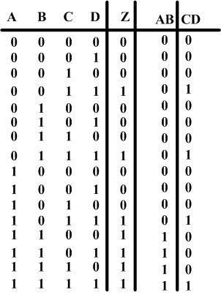
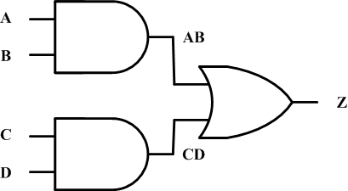
Truth table and logic diagram

Slide 26
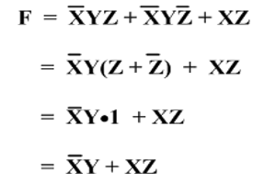
Can you think for f = x+y’z
Simplify F=X’YZ+X’YZ’+XZ
By distributive law
By Idempotent Law
By identity law

Slide 27
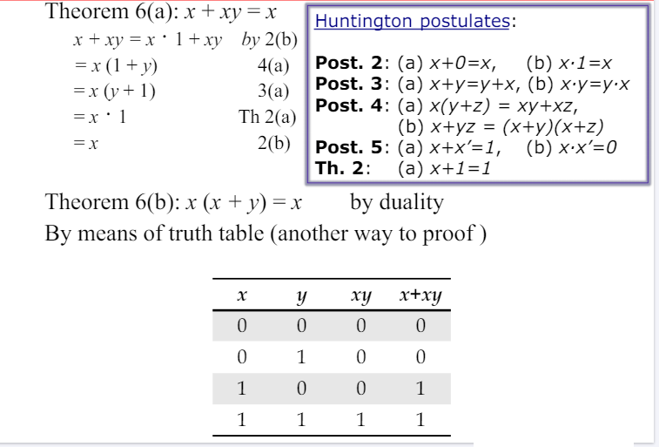
Absorption Property (example)

Slide 28
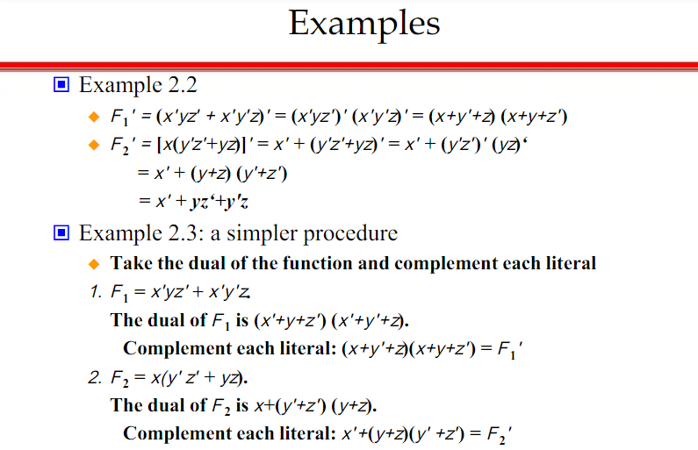

Slide 29
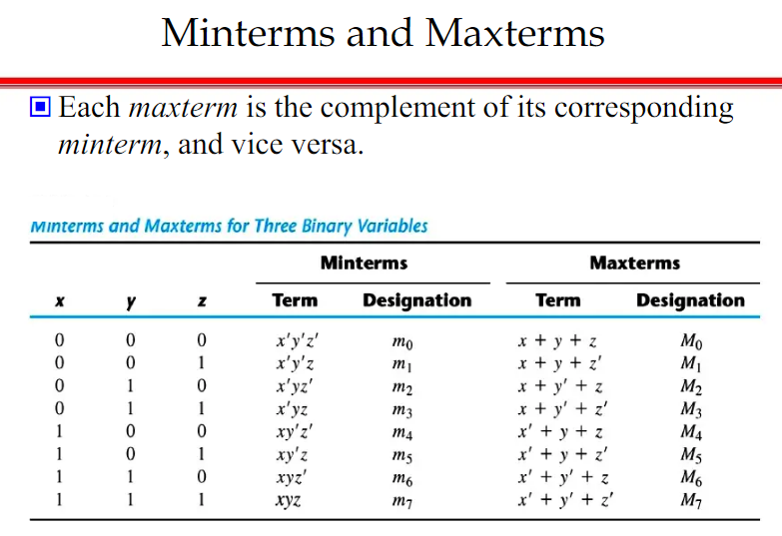

Slide 30
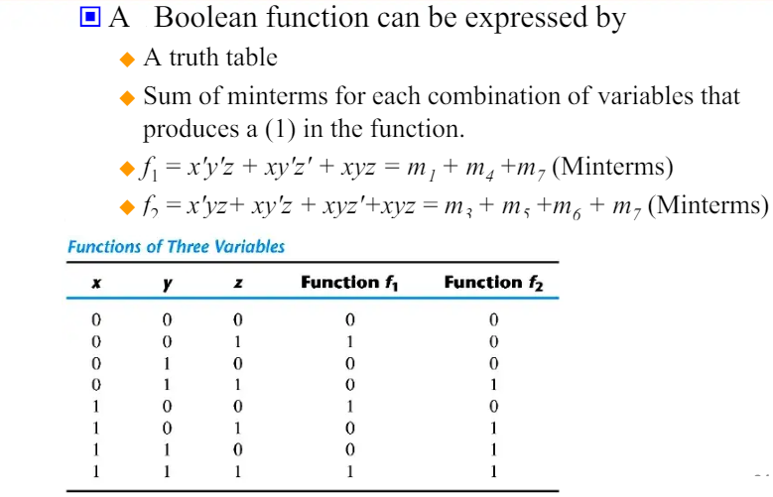

Slide 31
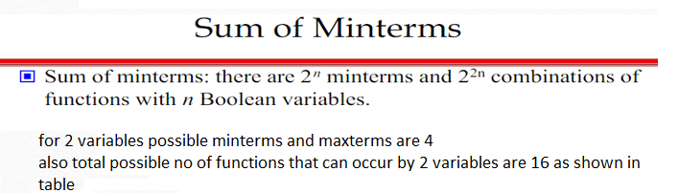
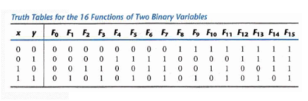

Slide 32

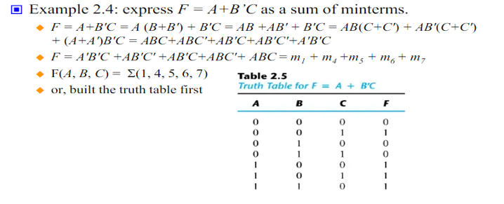

Slide 33
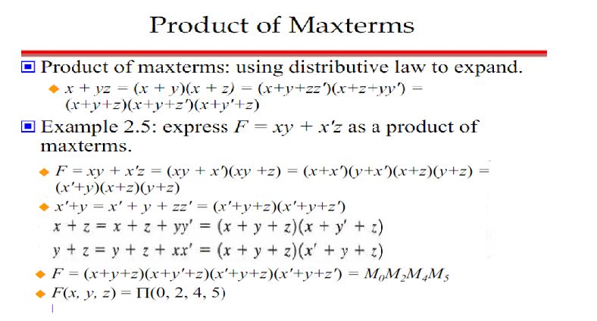

Slide 34



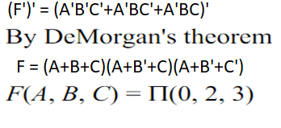
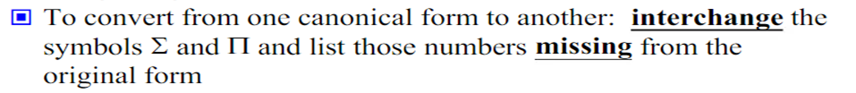
For example consider a function

Slide 35
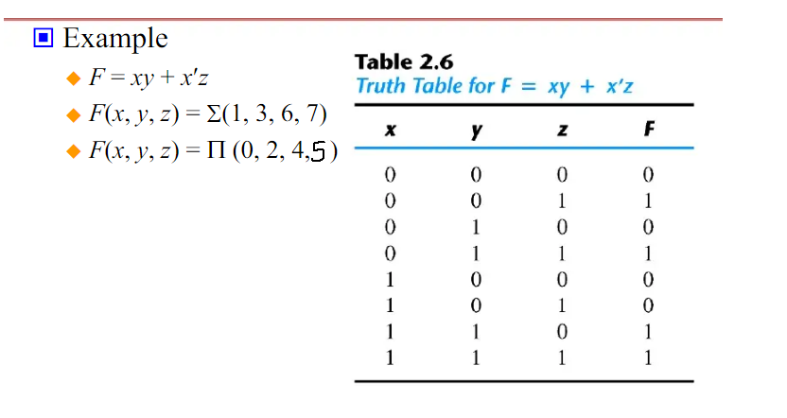

Slide 36
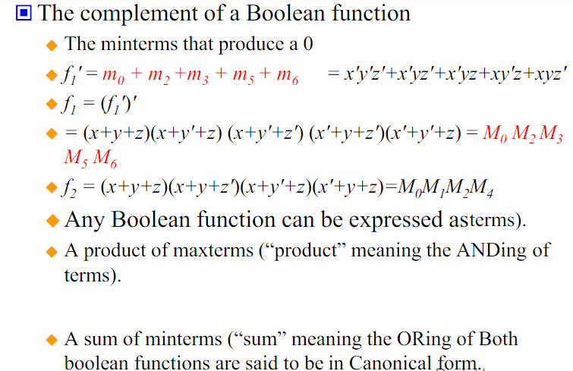

Slide 37
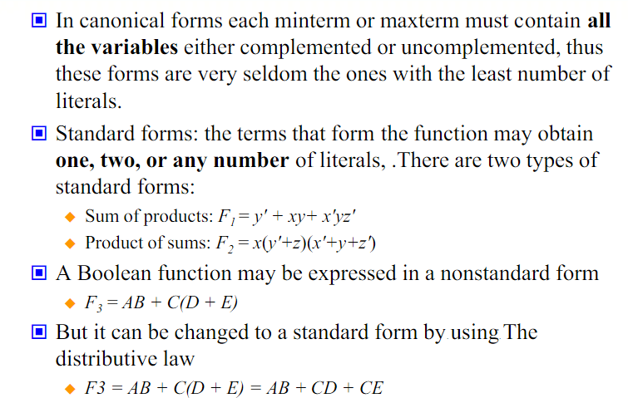
Standard Forms

